Slide 1
How to Navigate MSA-U
Need help? Email: msau@msasafety.com

Slide 2
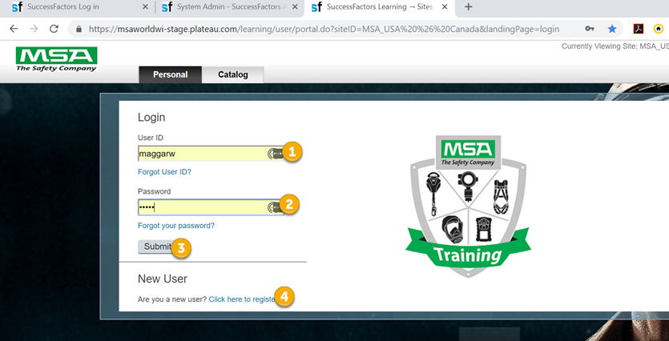
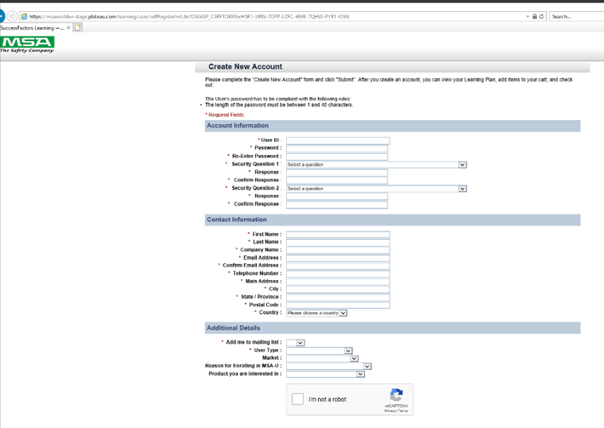
How to Log into MSA-U
Return user?
Enter your userid (email address)
Enter “Training1!” as your password
Click submit to connect to the system
You will immediately be ask to create a new password and setup security questions.
New User to MSA-U? Click on “Click here to register” to create an account. Enter the information on the form and click submit.
You will now be logged in to the MSA-U home page.
UserID & Password are CASE SENSITIVE

Slide 3
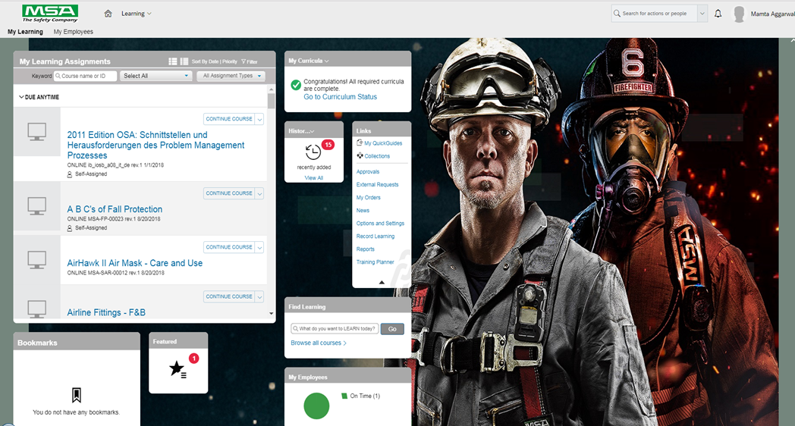
MSA-U Homepage
The starting point for navigating MSA’s new learning platform
The Home page is the starting point for navigating MSA-U. Tiles provide quick access to learning information and activities personalized to you and your role.

Slide 4
MSA-U Homepage
My Learning Assignments tile displays assigned learning activities. You can view your assignments and related details, launch training, and register for courses. It provides a consolidated view of courses requiring action.
All courses are listed in one place.
Courses are listed and grouped by Due Date.
Optional and Recommended training will have no due date.

Slide 5
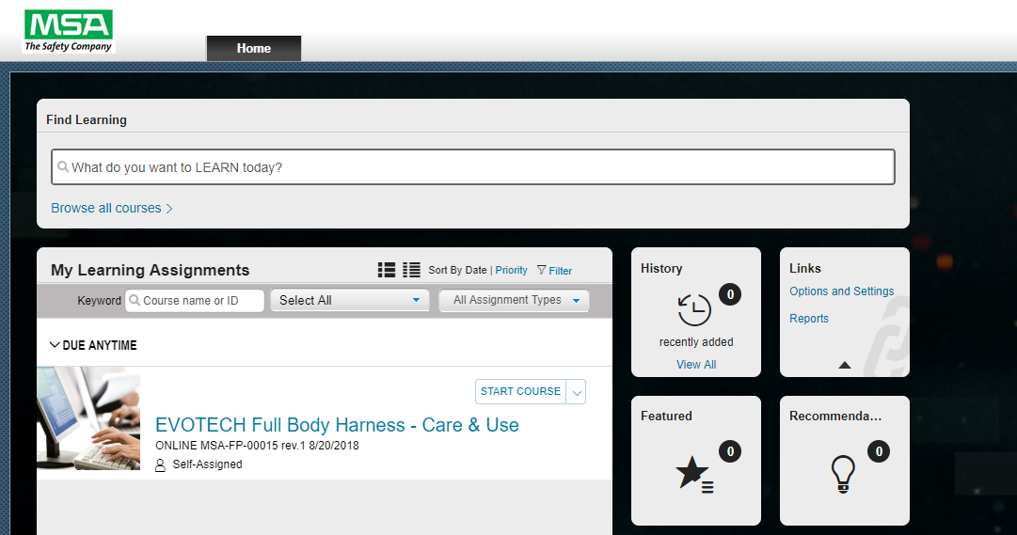
MSA-U Homepage
The My Learning Assignments tile includes buttons and statuses per course
Allows you to start a course – click the course title to start
Recommend a course
Remove the course from your assignments
One-click to display curriculum requirements.

Slide 6
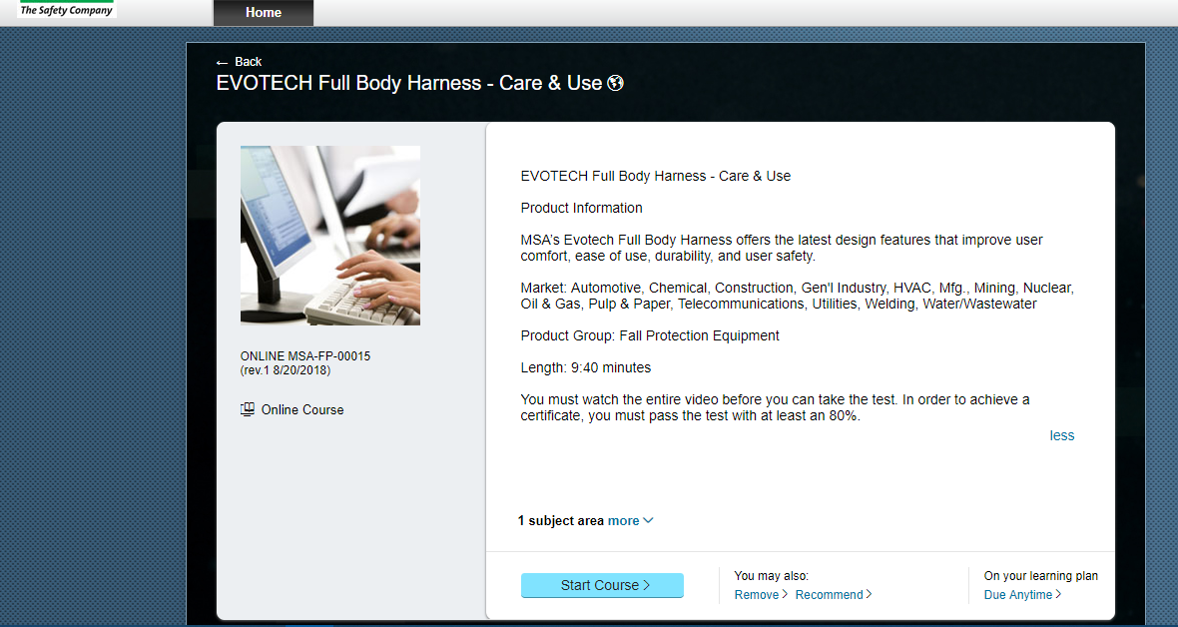
Learning Course Details Page
Basic information about the course is displayed:
The course description
Click more/less to expand/collapse subject areas and associated competencies
Recommend the course to others.
View assignment details

Slide 7
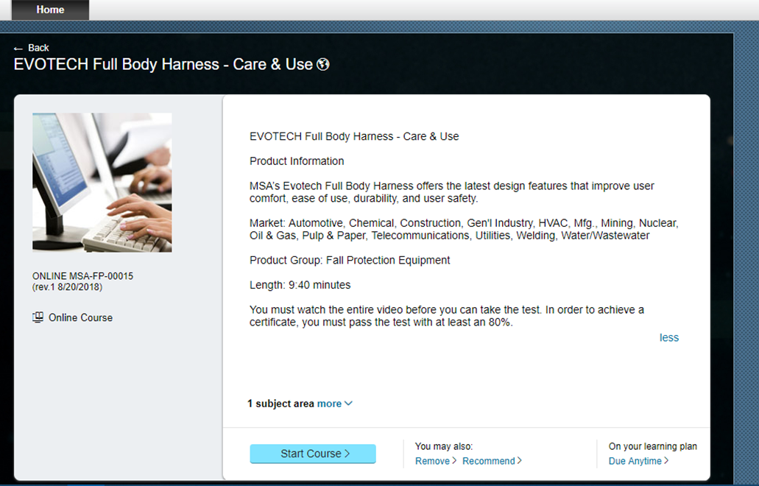
Launch an Online Course
Start Course: Launch a course.
Continue Course: Relaunch a course you have started.
Register Now: Register for a course assigned to you.
Remove Course: Remove a course that has been assigned to you

Slide 8
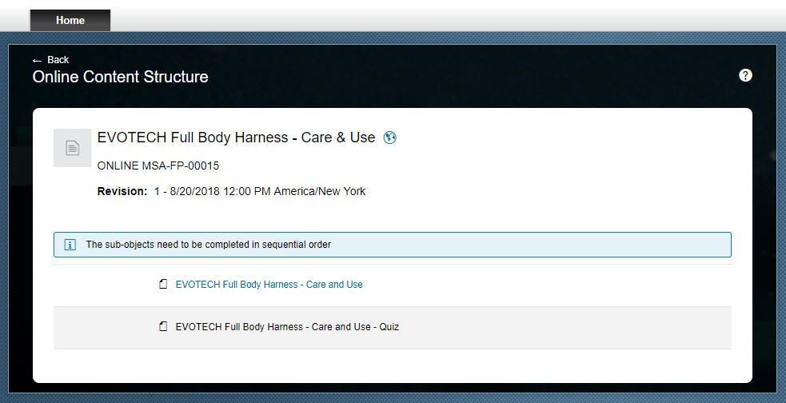
Launch an Online Course
The Online Content Structure window will launch once the page has loaded.
NOTE: Do not close the Online Content Structure window after you launch content. The window must stay open because it needs to record when you complete a content object.
Completed objects will be listed with the date of completion.

Slide 9
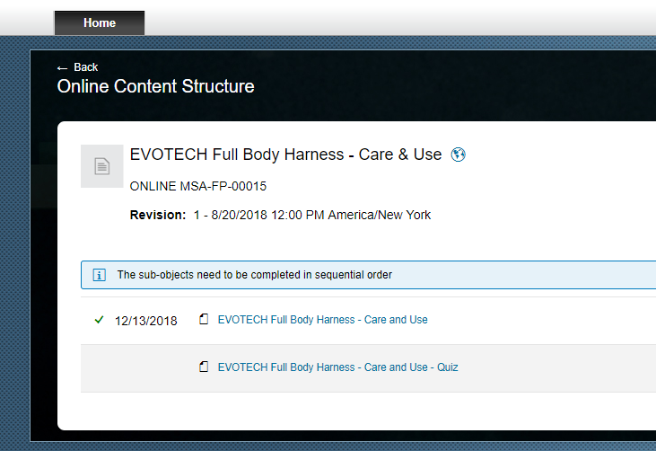
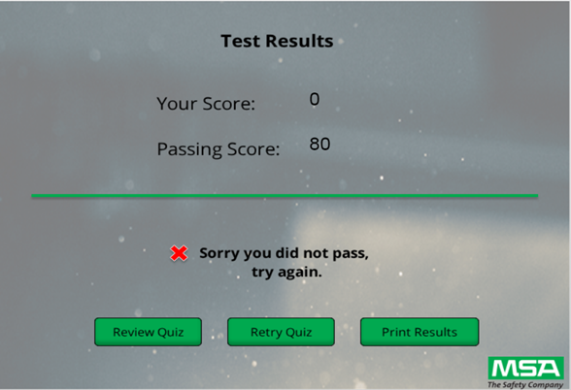
Learning Exams
You may access and complete directly from My Learning Assignments or by finding the item in the catalog.
Upon completion of an exam, your scores are tracked and the certificate will be available.
Results of exam are listed on the Learning History and completed work.

Slide 10
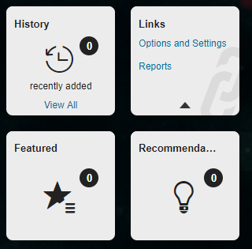
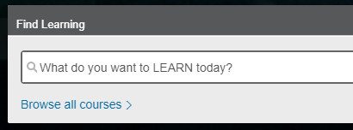
Tiles
Learning History
Access your completed work list by clicking the Learning History tile to view, search for, and sort for completed work.
The tile displays the number of recently recorded completions.
Click View all to view the Completed Work page.
Find Learning
Search for learning using the Find Learning tile.
Enter keywords into the text field and click Go.
Click Browse all courses to access the course catalog in MSA-U.

Slide 11
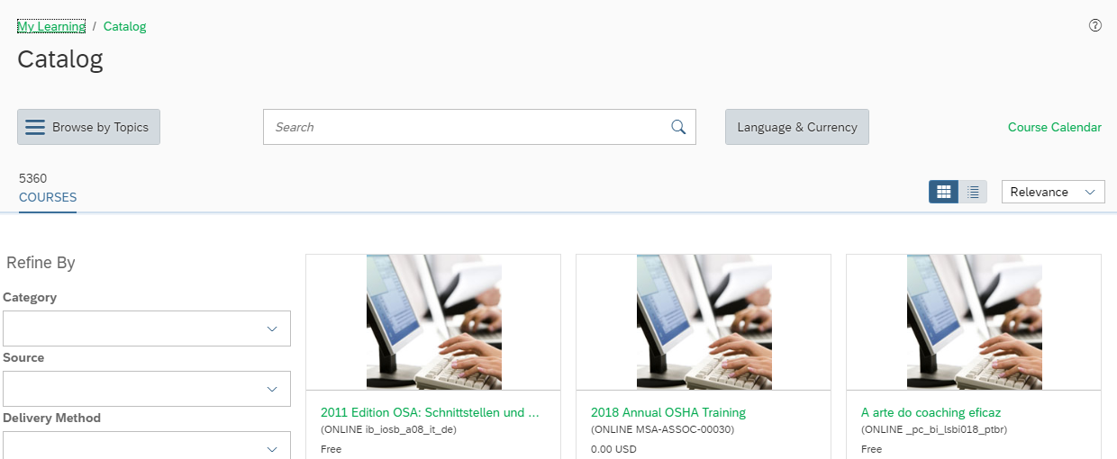
Catalog Search
The Learning Catalog is used to browse, search, launch a course, and enroll in learning activities.
Enter keywords related to the topic of the course, title, or other relevant information in the Search field. Be sure to enter the whole word in the search, partial words will not return results.

Slide 12
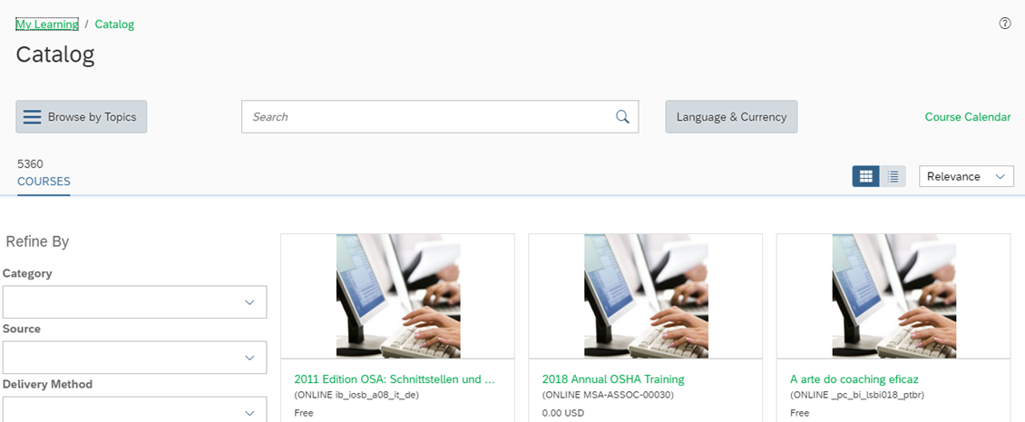
Catalog Search
Click on the Language link to switch between the language collections of training activities. NOTE: Languages are only displayed for the selected language in your Options and Settings.
The search results table lists the applicable learning activities:
The course type, category, and schedule
Click a course title to view additional details about the learning activity
Hover your mouse over a course to display available actions:
Add to Learning Plan: create an assignment for the course
A Start Course link displays here for online courses so you can start the training

Slide 13
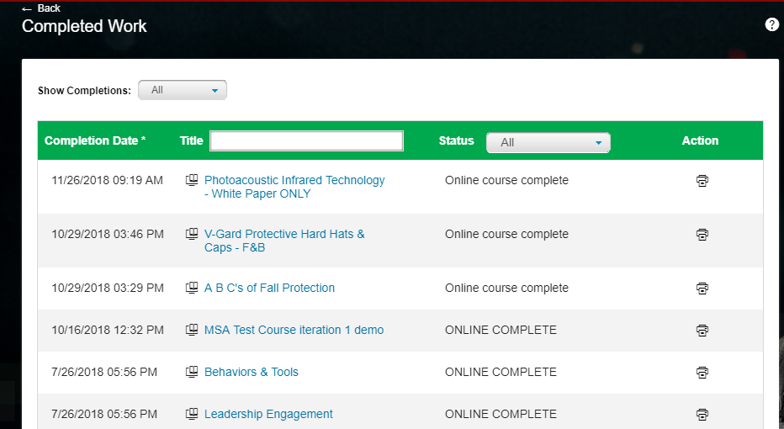
Learning History / Completed Works
Learning History provides a view of completed courses. Here you are able to track and manage learning, view the courses you have completed, and print certificates. Completed work is a historical list of all the activities that you have completed.

Slide 14
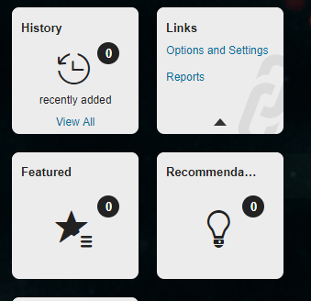
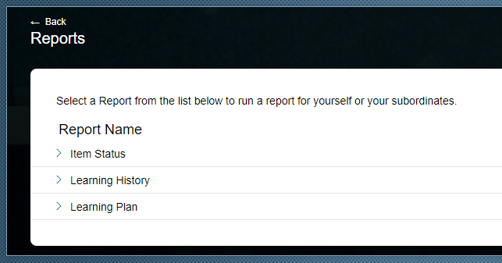
Reports
MSA-U can generate reports about your learning. Reporting is accessible via Links on the Home page.
Reporting lists a variety of reports, by category, which can be used for compliance and audit history by the employee.
Employee and managers may only access reports about his/herself and his/her employees and learning records.

Slide 15
Reports
Select a Report for yourself or your subordinates.

Slide 16
Contact Us
MSA-U Site Administrator
msau@msasafety.com
MSA Training
training@msasafety.com
866.347.6093
Customer Service
Info.us@msasafety.com
800.MSA.2222

Slide 17
Connect with us
facebook.com/MSAsafety
youtube.com/MSAsafety
linkedin.com/company/ msa-the-safety-company
facebook.com/MSAsafetyFire

Slide 18
THANK YOU!
Any questions?

